Slide 1







Next Gen Employability Program
NEXT GEN EMPLOYABILITY PROGRAM Creating a future-ready workforce
Team Members
College Name
Student Name: Vasanth M Student ID: au814721104058
SRM TRP ENGINEERING COLLEGE

Slide 2

Next Gen Employability Program
CAPSTONE PROJECT SHOWCASE
Project Title
Notes Sharing Web Application using Django Framework
Abstract | Problem Statement | Project Overview | Proposed Solution | Technology Used | Modelling & Results | Conclusion

Slide 3
Next Gen Employability Program
Abstract
Put simply, our goal is to create a web app using Django where people can easily share their notes. You'll be able to create, upload, view, and share notes with others, all in one place. Plus, you can sign up for an account, log in securely, and manage your notes right from the platform.
We're making security a top priority too. We'll use secure methods to verify users, encrypt data, and control who can access each note. This way, your information stays safe and private.
In short, our Notes Sharing Web Application will be a user-friendly and secure space for collaboration, knowledge exchange, and efficient note management.

Slide 4
Next Gen Employability Program
Problem Statement
.In today's fast-moving digital landscape, people frequently face hurdles in efficiently managing and distributing notes. Whether it's students teaming up on group assignments, professionals exchanging meeting insights, or enthusiasts sharing information, there's a clear demand for a unified platform that streamlines note creation, organization, and dissemination.
The Issue of Fragmented Tools: Users often struggle to locate a single platform that encompasses all the essential functionalities for creating, organizing, and sharing notes seamlessly.
Security Gaps: Many current solutions fall short in providing robust security measures to safeguard user data, sparking worries about privacy and confidentiality.

Slide 5
Next Gen Employability Program
Project Overview
In the realm of note-taking and sharing, users face several obstacles that hinder their productivity and collaborative endeavors. These challenges include:
Tool Fragmentation: Users frequently rely on multiple applications or tools for note-taking, organization, and sharing. This fragmentation can result in inefficiencies as users must navigate between various platforms, each with its unique interface and functions.
Security Apprehensions: Numerous note-sharing platforms may lack adequate security measures, leaving user data susceptible to breaches or unauthorized access. Without proper encryption and authentication mechanisms, users may be reluctant to share sensitive information through these platforms.

Slide 6
Next Gen Employability Program
Proposed Solution
In summary, the Notes Sharing Web Application, built on the Django framework, offers a comprehensive solution to common challenges in note-taking, organization, and sharing. Here's how it addresses each issue:
Centralization:
The application serves as a centralized hub where users can perform all note-related tasks seamlessly, from creation to sharing. This eliminates the need to juggle multiple tools or platforms, streamlining the user experience.
Security Features:
To safeguard user data, the application implements robust security measures such as encryption for sensitive information, secure authentication methods like OAuth or JWT, and role-based access control to manage user permissions effectively. These measures ensure the safety and privacy of user data throughout the platform.

Slide 7
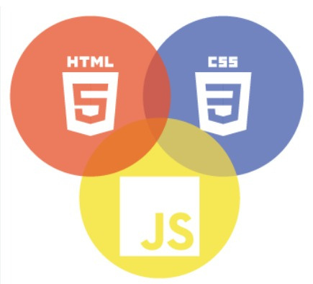

Next Gen Employability Program
Technology Used
Front-end
Back-end

Slide 8
Next Gen Employability Program
Modelling & Results
In summary, here's how the application's modeling and functionality enhance the user experience:
Database Modeling:
Utilizing Django's ORM, the application structures its database tables efficiently, ensuring seamless data management and retrieval.
Search and Organization:
Users benefit from a robust search feature enabling them to find notes effortlessly based on various criteria like keywords, titles, categories, or tags.
Overall Impact:
The Notes Sharing Web Application, powered by Django, offers users a centralized platform for efficient note creation, organization, and sharing. With seamless collaboration features and real-time communication, users can effectively manage their notes and collaborate with others hassle-free.

Slide 9
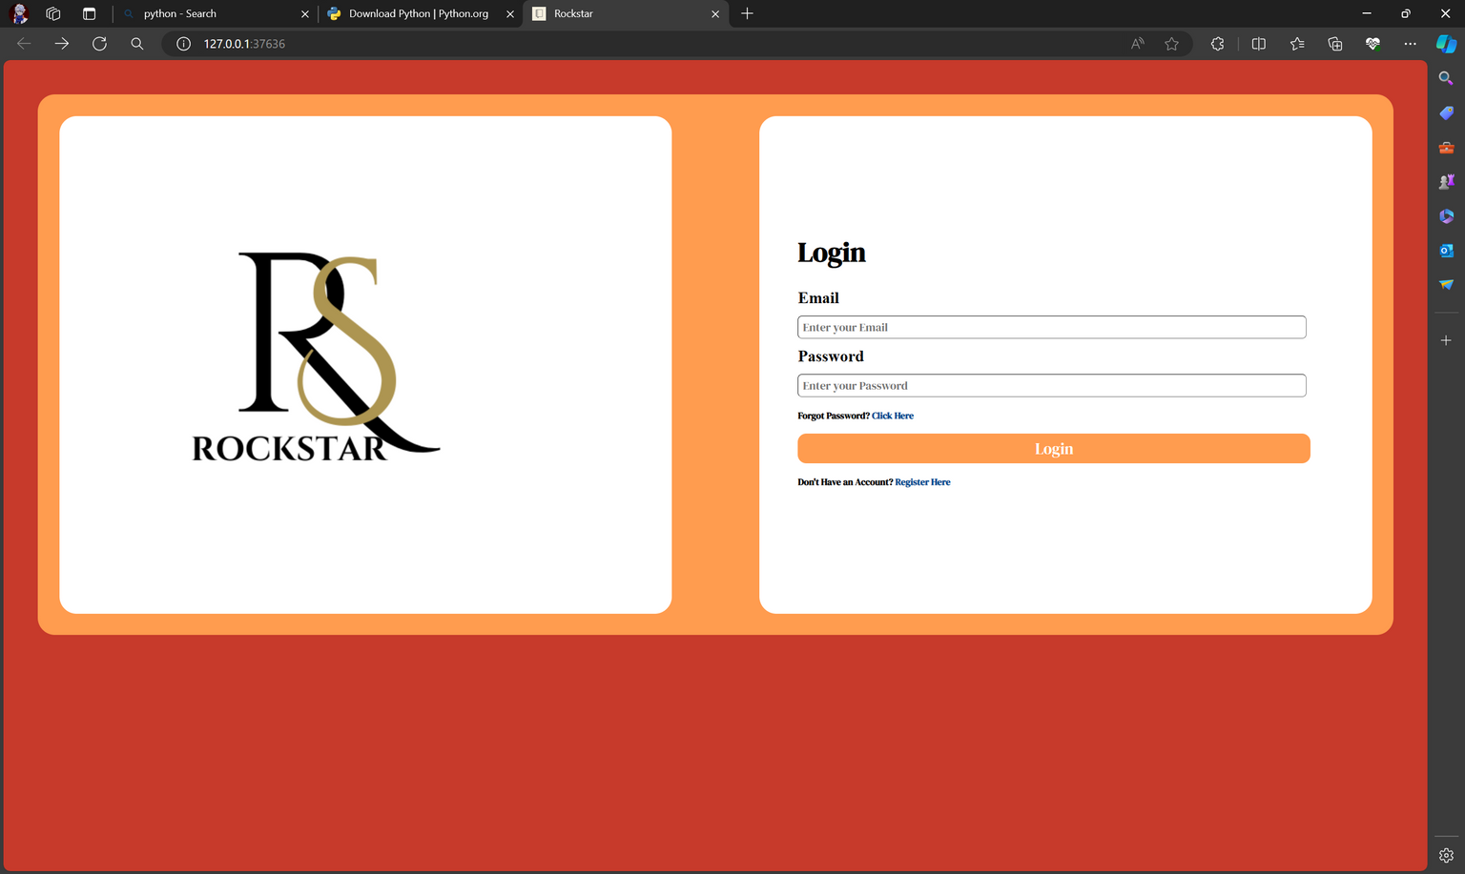
Next Gen Employability Program
Login page

Slide 10
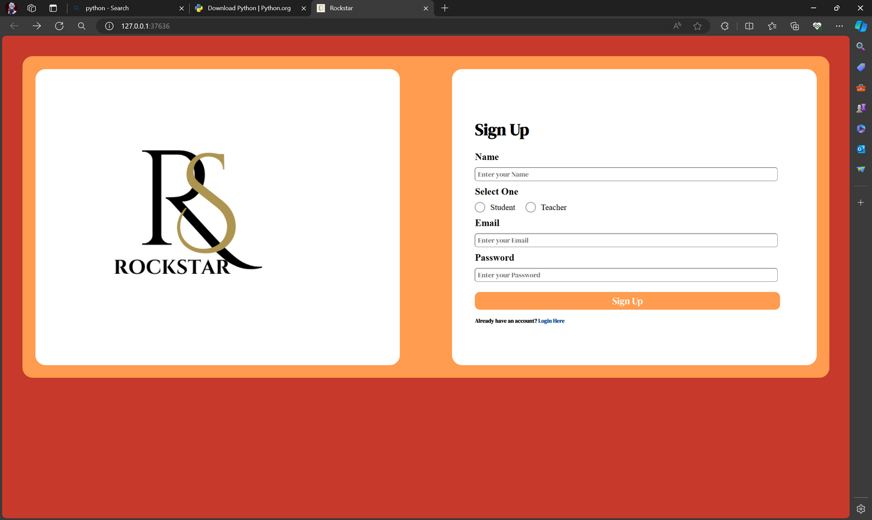
Next Gen Employability Program
Sign up page

Slide 11
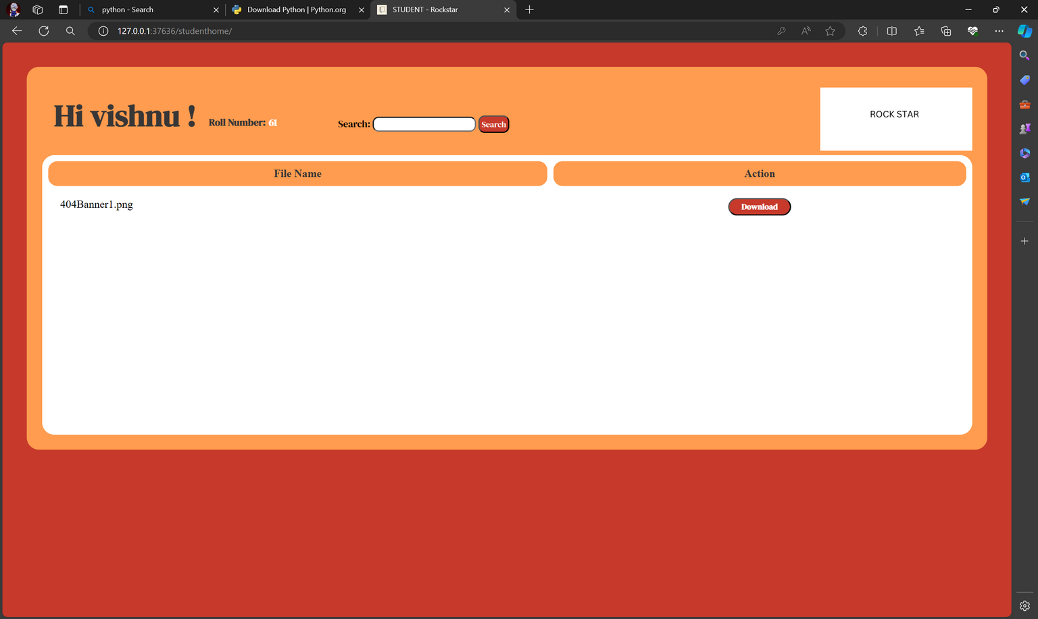
Next Gen Employability Program
Student’s page

Slide 12
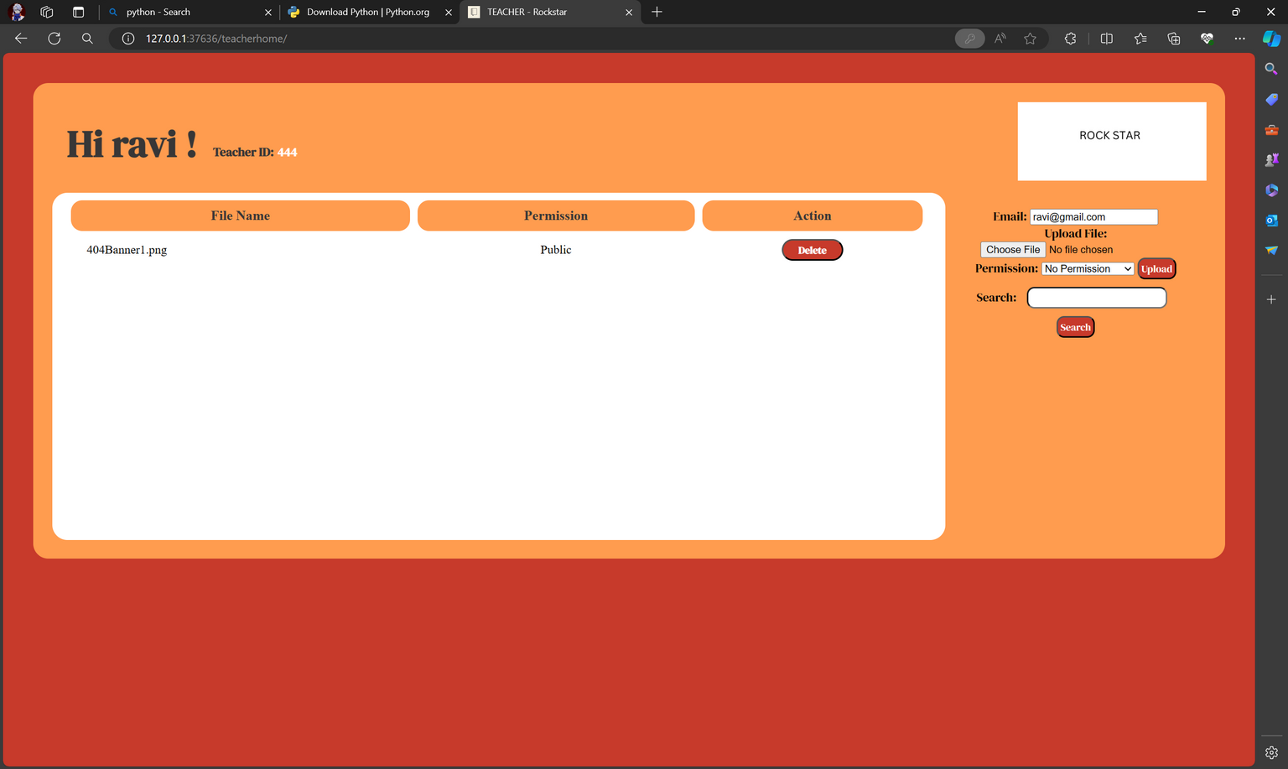
Next Gen Employability Program
Teacher’s page

Slide 13
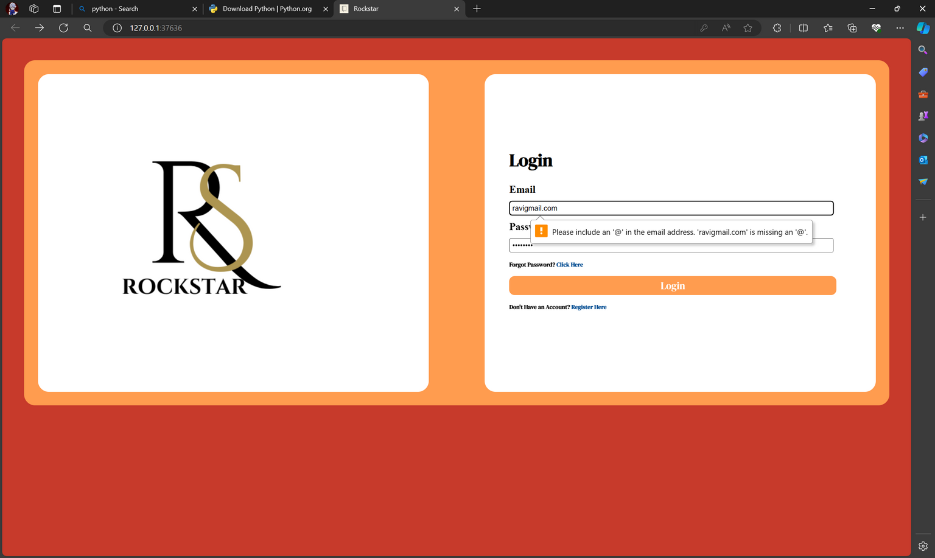
Next Gen Employability Program
Error page

Slide 14
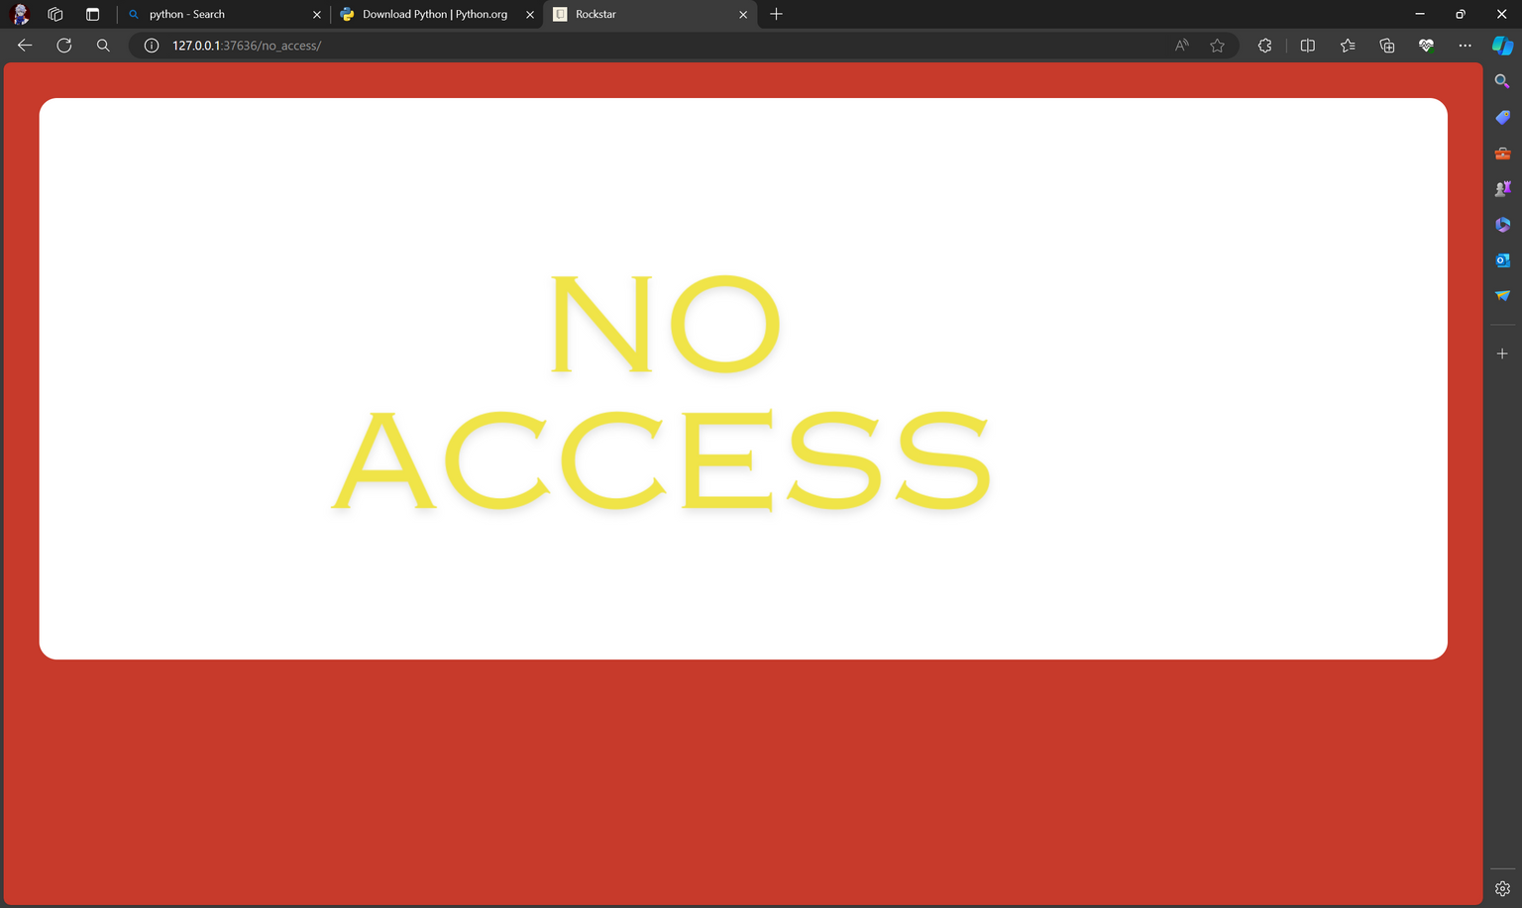
Next Gen Employability Program
No access

Slide 15
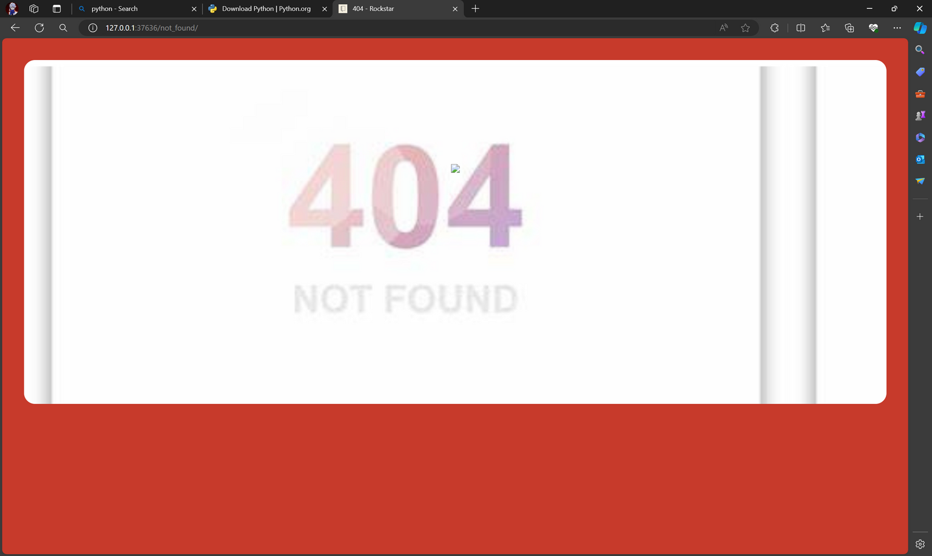
Next Gen Employability Program
404 error

Slide 16
Next Gen Employability Program
Future Enhancements
- **Advanced Collaboration Features:** Users can collaborate in-depth, track changes, and communicate in real-time.
- **Integration with External Tools:** Seamless integration
with external tools enhances functionality and workflow.
- **Enhanced Security Measures:** Robust security protocols ensure the safety and privacy of user data.
- **Mobile Application Support:** The application is accessible via mobile devices, ensuring users can access notes on the go.
- **Offline Access and Synchronization:** Users can access and synchronize notes even without an internet connection.

Slide 17
Next Gen Employability Program
Conclusion
In summary, the Notes Sharing Web Application, developed on Django, offers a comprehensive solution to note-taking challenges. With its centralized platform, robust security measures, advanced collaboration features, and user-friendly interface, the app streamlines workflows and fosters seamless knowledge sharing.
Ultimately, it serves as a valuable tool for individuals, teams, and organizations looking to enhance productivity and collaboration. Through ongoing refinement and innovation, the application continues to evolve, remaining a vital asset for users striving for excellence in productivity and collaboration.

Slide 18
Next Gen Employability Program
Thank You!

